Slide 1

  Intelligent Virtual Machine Placement and Energy-Aware Data Center Management in a car manufacturing company
  Team no. 8
  CSA1520 – Cloud computing and Big Data analytics
  Guided By Students Name
  Dr.A.M.Arul Raj A . Tharun Kumar R (192572068) Professor K . Lohith Kumar(192511155)
  p . Vinaya(192324186)
Notes:
1
1

Slide 2
Abstract
The manufacturing companies use data c enters to manage production, vehicle design, inventory, and quality control.
These data c enters require high computing power and consume a large amount of energy.
Traditional virtual machine (VM) placement methods may waste resources and increase electricity costs.
This project aims to develop an intelligent system for placing virtual machines on physical servers efficiently.
The system considers CPU usage, memory requirements, workload, and power consumption.

Slide 3
Aim and Objective
Aim
To develop an intelligent virtual machine placement system that reduces energy consumption and improves resource utilization in the data c enter of a car manufacturing company.
Objectives
Efficient VM Placement: Allocate virtual machines to suitable physical servers based on resource requirements.
Energy Reduction: Reduce electricity consumption by optimizing server usage.
Resource Utilization: Improve the utilization of CPU and memory resources.
Load Balancing: Distribute workloads evenly among physical servers.

Slide 4
Introduction
These data c enters run many applications and require high computing resources.
Virtual machines (VMs) help run multiple applications on physical servers efficiently.
Improper VM placement can lead to high energy consumption, server overload, and resource wastage.
Intelligent VM placement helps allocate virtual machines to suitable servers based on CPU, memory, and workload requirements.

Slide 5
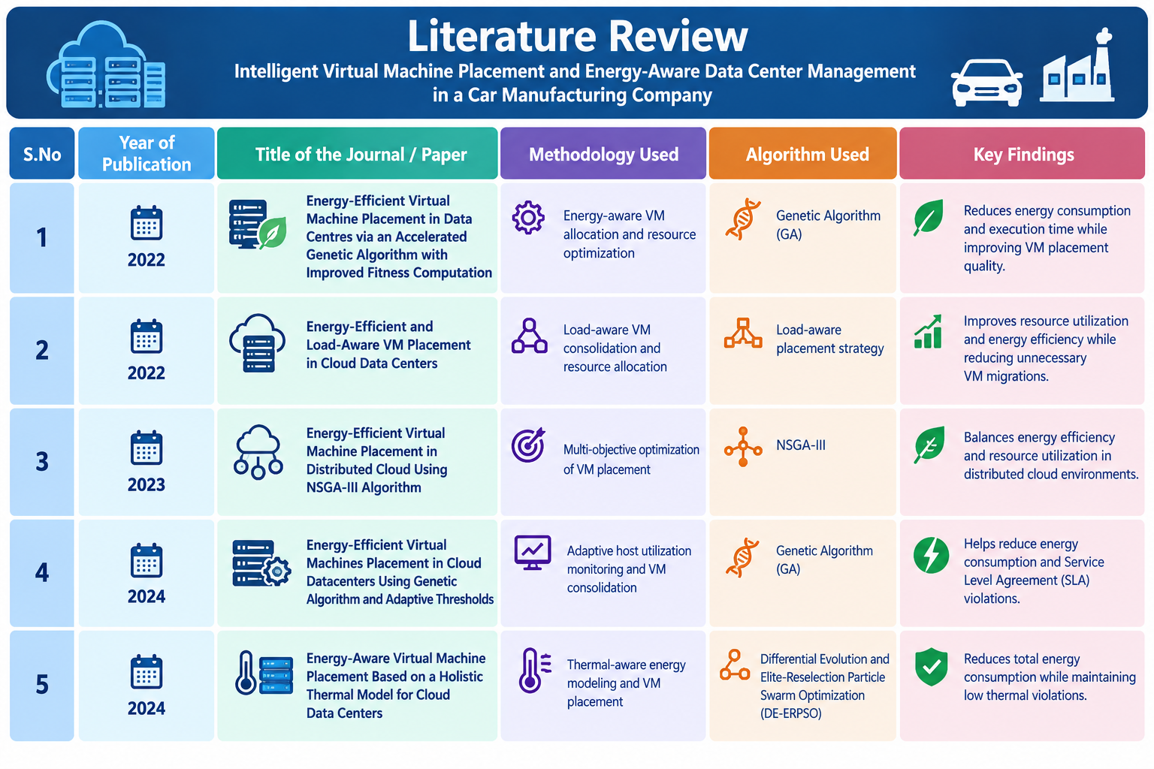
Literature Review

Slide 6
Problem Statement
Data Centers in car manufacturing companies consume high amounts of electricity.
Improper VM placement leads to resource wastage.
Uneven workloads cause server overloading.
High power consumption increases operating costs.
Idle servers waste energy when left running.
Traditional methods may not optimize energy and resources

Slide 7
Existing System
Traditional methods are used to place virtual machines on physical servers.
VM placement is mainly based on CPU and memory requirements.
Workloads may not be distributed evenly across servers.
High energy consumption increases electricity costs.
Idle servers continue consuming power.

Slide 8
Proposed System
Uses intelligent algorithms for efficient virtual machine placement.
Allocates VMs based on CPU, memory, and workload requirements.
Reduces energy consumption by optimizing server usage.
Balances workloads across physical servers.
Switches idle servers to low-power modes when possible.

Slide 9
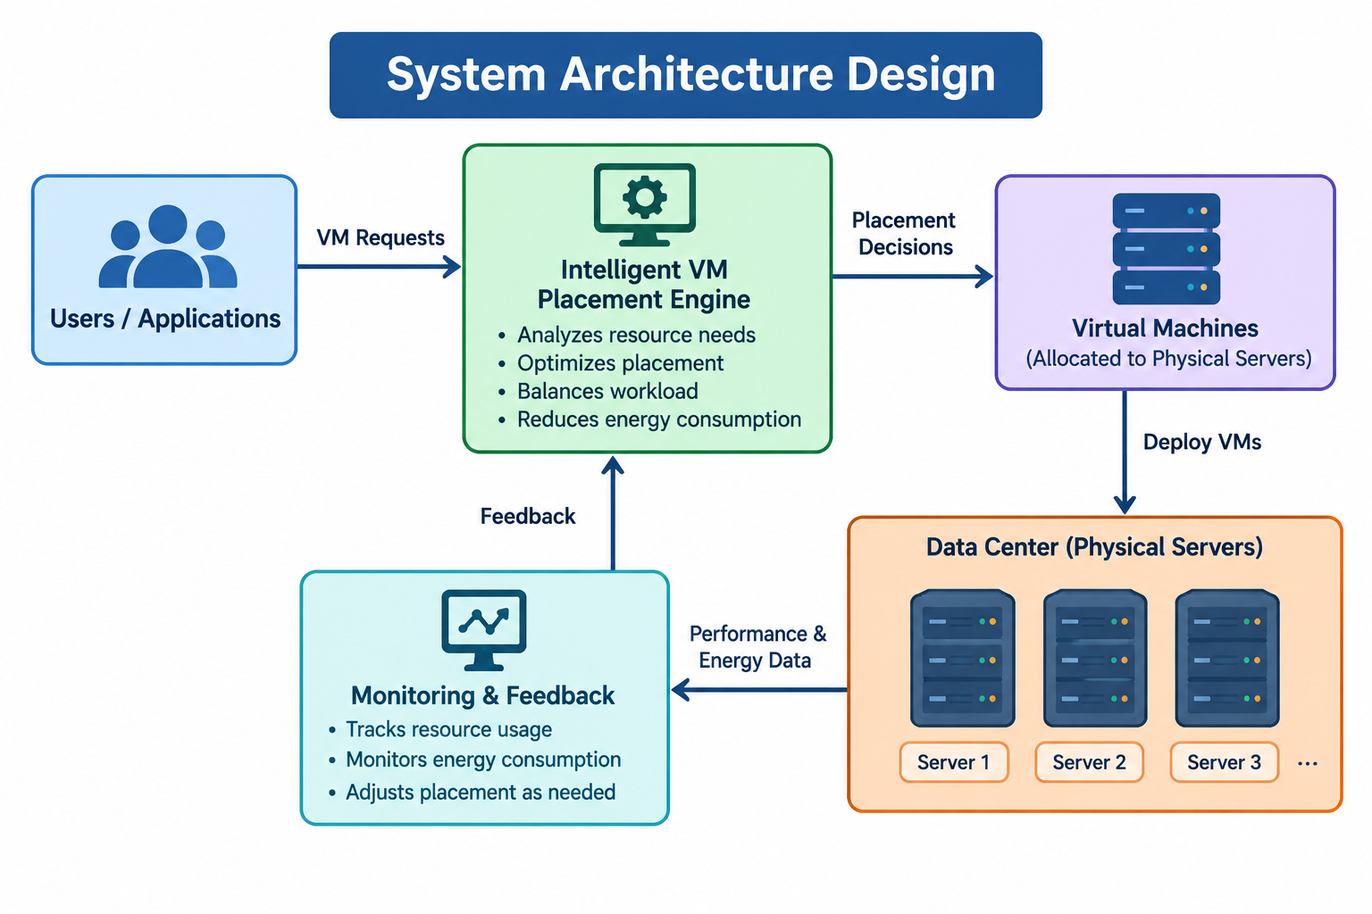
System Architecturel Design

Slide 10


Sustainable Development Goal (SDG) Implementation
SDG 9: Industry, Innovation and Infrastructure
Uses intelligent algorithms to improve data Center management.
Supports efficient and reliable manufacturing IT systems.
Encourages technological innovation in the automotive industry.

Slide 11
Design & Module Planning
MODULE 1: Virtual Machine Placement:
Efficiently allocate virtual machines to physical servers in the car manufacturing company.
MODULE 2: Energy-Aware Resource Management:
Monitor and optimize CPU, memory, and server resources to reduce energy consumption.
MODULE 3: Load Balancing and Workload Optimization
Distribute workloads across servers to improve performance and prevent resource overload.
MODULE 4: Power Consumption Monitoring and Optimization:
Track data Center energy usage and minimize electricity costs while maintaining system reliability.

Slide 12
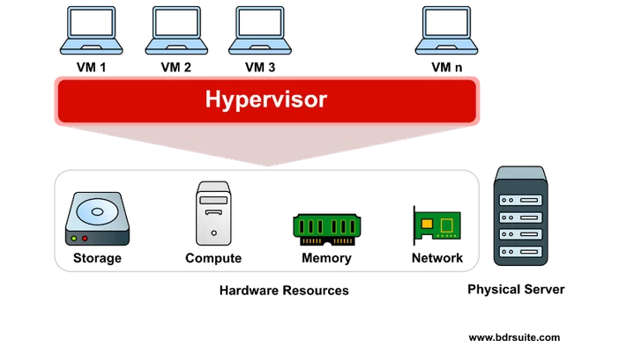
MODULE 1: Virtual Machine Placement
Uses virtual machines to manage manufacturing operations.
Allocates VMs to suitable physical servers.
Monitors CPU, memory, and energy consumption.
Reduces power usage and operational costs.

Slide 13
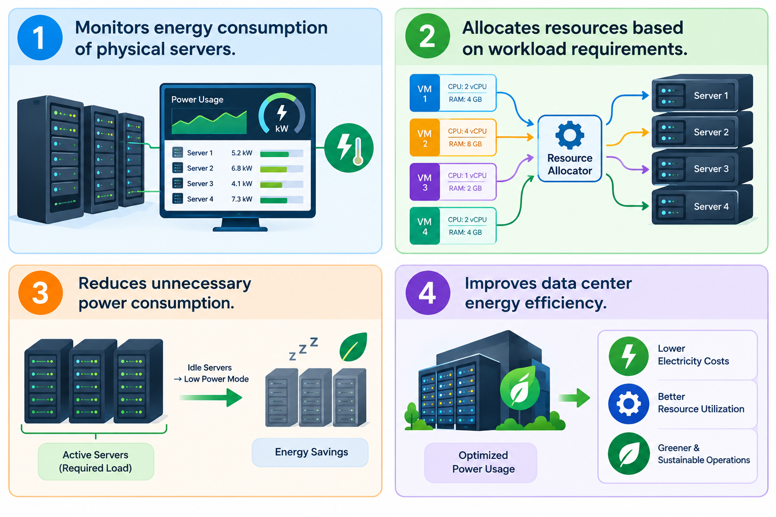
MODULE 2: Energy-Aware Resource Management:
Monitors energy consumption of physical servers.
Allocates resources based on workload requirements.
Reduces unnecessary power consumption.
Improves data center energy efficiency.

Slide 14
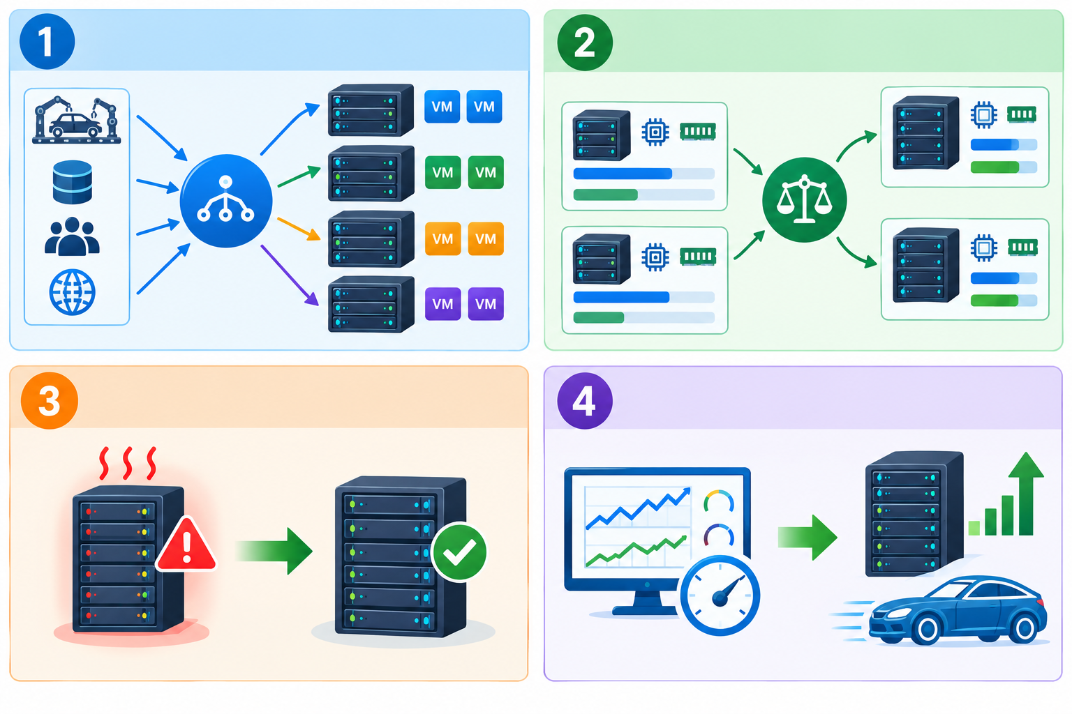
MODULE 3: Load Balancing and Workload Optimization
Distributes workloads across physical servers.
Balances CPU and memory utilization.
Prevents server overload.
Improves application performance and efficiency.

Slide 15
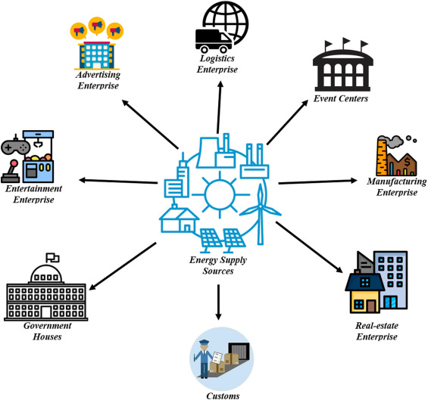
MODULE 4: Power Consumption Monitoring and Optimization:
Monitors power consumption of physical servers.
Identifies energy wastage in data centers.
Optimizes server power usage.
Reduces electricity costs.
Improves energy efficiency.
Supports sustainable manufacturing operations.

Slide 16
Conclusion
Intelligent Virtual Machine Placement and Energy-Aware Data Center Management helps a car manufacturing company optimize server resources, reduce power consumption, minimize operational costs, and improve data center performance. This approach supports efficient, reliable, and sustainable IT infrastructure.

Slide 17
References
1. United Nations. (n.d.). Goal 9: Industry, Innovation and Infrastructure. https://sdgs.un.org/goals/goal9
2. United Nations. (n.d.). The 2030 Agenda for Sustainable Development. https://sdgs.un.org/2030agenda
3. Li, Z., Lin, K., Cheng, S., et al. (2022). Energy-Efficient and Load-Aware VM Placement in Cloud Data Centers. Journal of Grid Computing, 20, Article 39. https://doi.org/10.1007/s10723-022-09631-0
4. Energy-Aware Virtual Machine Placement Based on a Holistic Thermal Model for Cloud Data Centers. (2024). Future Generation Computer Systems, 161, 302–314. https://doi.org/10.1016/j.future.2024.07.020
5. Zhou, Z. (2016). Virtual Machine Placement Algorithm for Both Energy-Awareness and SLA Violation Reduction in Cloud Data Centers. Scientific Programming. https://doi.org/10.1155/2016/5612039

Slide 18


